Slide 1
Image Segmentation
Dr. Rafiqul Islam
Dept of CSE

Slide 2
Image Segmentation
Segmentation divides an image into its constituent regions or objects.
Segmentation of images is a difficult task in image processing. Still under research.
Segmentation allows to extract objects in images.

Slide 3
What it is useful for
After a successful segmenting the image, the contours of objects can be extracted using edge detection and/or border techniques.
Shape of objects can be described.
Based on shape, texture, and color objects can be identified.
Image segmentation techniques are extensively used in similarity searches.

Slide 4
Applications
3D – Imaging : A basic task in 3-D image processing is the segmentation of an image which classifies voxels/pixels into objects or groups.
3-D image segmentation makes it possible to create 3-D rendering for multiple objects and perform quantitative analysis for the size, density and other parameters of detected objects.
Several applications in the field of Medicine like magnetic resonance imaging (MRI).

Slide 5
Segmentation Algorithms
Segmentation algorithms are based on one of two basic properties of color, gray values, or texture: discontinuity and similarity.
First category is to partition an image based on abrupt changes in intensity, such as edges in an image.
Second category are based on partitioning an image into regions that are similar according to a predefined criteria. Histogram thresholding approach falls under this category.

Slide 6
Segmentation Algorithms
Grey-Level Segmentation
Thresholding with a single threshold
Thresholding with a pair of thresholds

Slide 7
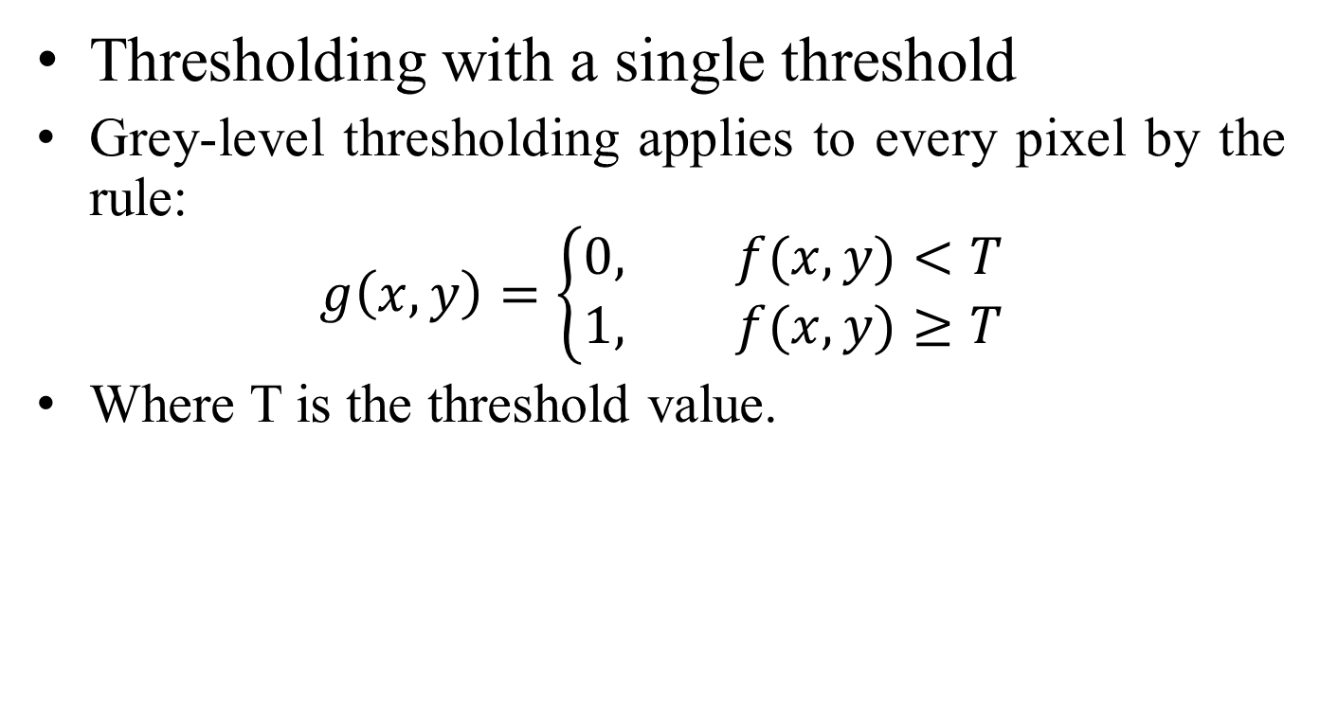
Grey-Level Segmentation
Thresholding with a single threshold
Grey-level thresholding applies to every pixel by the rule:
$$g\left(x,y\right)=\left\{\begin{aligned}0, f(x,y)<T \\ 1, f(x,y)≥T\end{aligned}\right.$$
Where T is the threshold value.

Slide 8
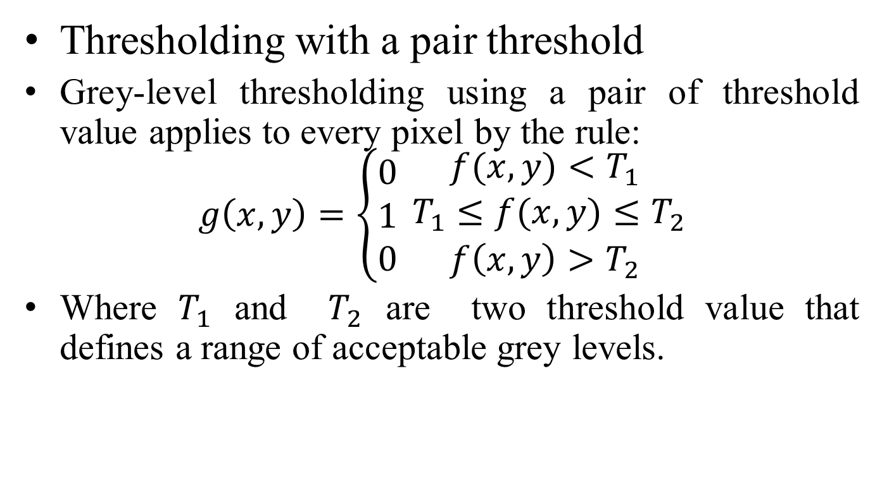
Grey-Level Segmentation
Thresholding with a pair threshold
Grey-level thresholding using a pair of threshold value applies to every pixel by the rule:
$$g\left(x,y\right)=\left\{\begin{aligned}0 \\ 1 \\ 0\end{aligned}\right.\begin{matrix}f(x,y)<T_{1} \\ T_{1}≤f(x,y)≤T_{2} \\ f\left(x,y\right)>T_{2}\end{matrix}$$
Where $T_{1}$ and $T_{2}$ are two threshold value that defines a range of acceptable grey levels.

Slide 9
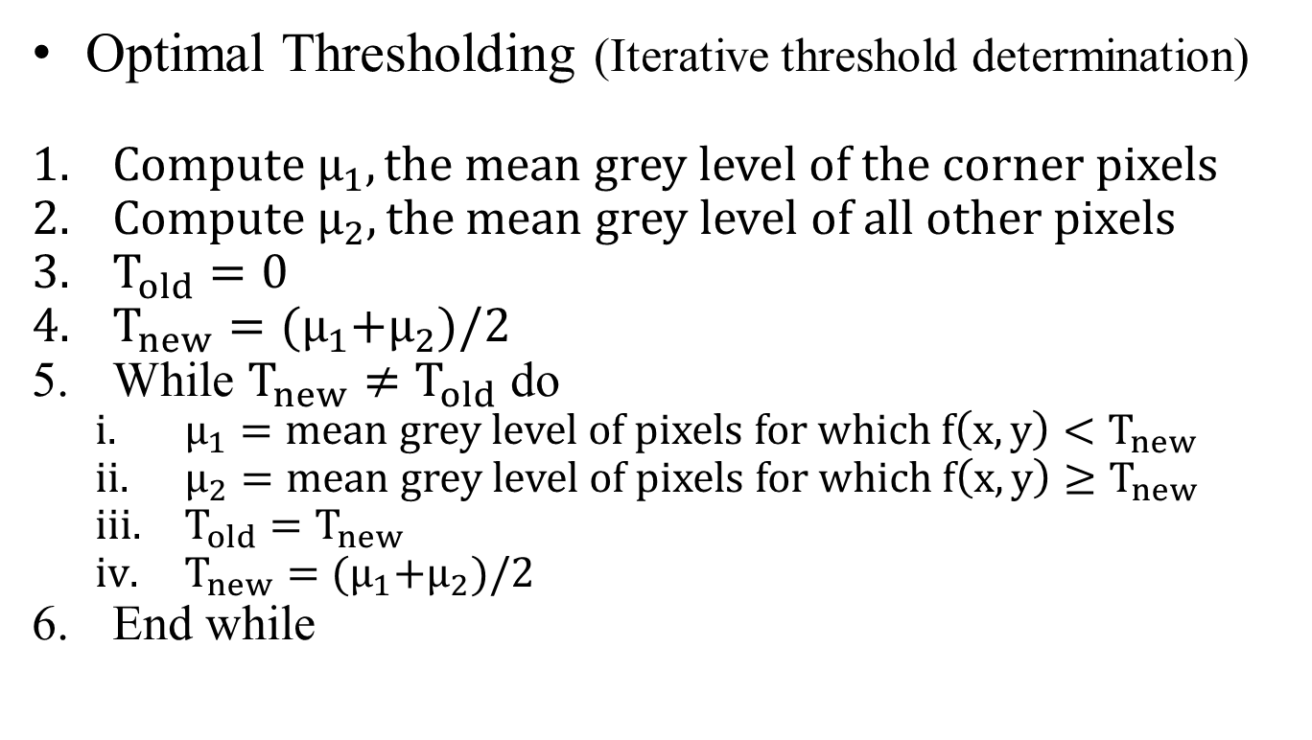
Grey-Level Segmentation
Optimal Thresholding (Iterative threshold determination)
$Compute μ_{1}, the mean grey level of the corner pixels$
$Compute μ_{2}, the mean grey level of all other pixels$
$T_{old}=0$
$T_{new}={(μ}_{1}+μ_{2})/2$
While $T_{new}≠T_{old}$ do
$μ_{1}=mean grey level of pixels for which f\left(x,y\right)<T_{new}$
$μ_{2}=mean grey level of pixels for which f\left(x,y\right)≥T_{new}$
$T_{old}=T_{new}$
$T_{new}={(μ}_{1}+μ_{2})/2$
End while

Slide 10
Improving Segmentation
Morphological operation
Dilation
Erosion

Slide 11
Improving Segmentation
Dilation operation
The value of the output pixel is the maximum value of all pixels in the neighborhood. In a binary image, a pixel is set to 1 if any of the neighboring pixels have the value 1.
Morphological dilation makes objects more visible and fills in small holes in objects.

Slide 12
Improving Segmentation
Erosion operation
The value of the output pixel is the minimum value of all pixels in the neighborhood. In a binary image, a pixel is set to 0 if any of the neighboring pixels have the value 0.
Morphological erosion removes islands and small objects so that only substantive objects remain.

Slide 13
Matlab Link
https://www.mathworks.com/help/images/morphological-dilation-and-erosion.html
https://www.mathworks.com/help/images/image-analysis.html
https://www.mathworks.com/help/images/image-segmentation.html?s_tid=CRUX_lftnav

Slide 14
Other Segmentation method
Edge-based
Point
Line
Edge detection
Region-based
Seeded region growing
Unseeded region growing
Fast scanning

Slide 15
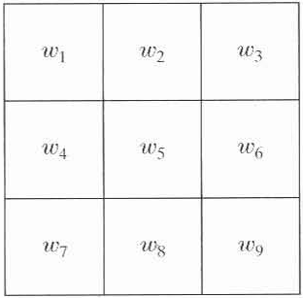
Edge-based segmentation
There are three basic types of gray-level discontinuities in a digital image: points, lines, and edges
The most common way to look for discontinuities is to run a mask through the image.
We say that a point, line, and edge has been detected at the location on which the mask is centered if ,where

Slide 16
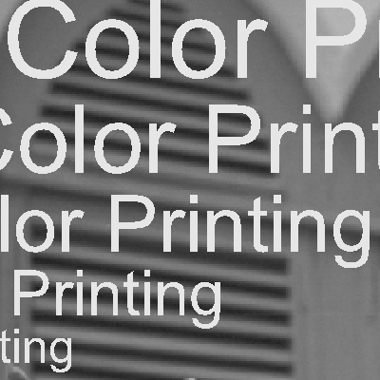

Edge-based Techniques
Segmentation
by boundary
detection
Edge
detection
Classification
and analysis

Slide 17
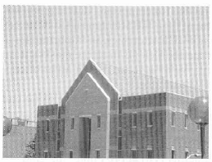
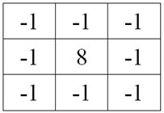
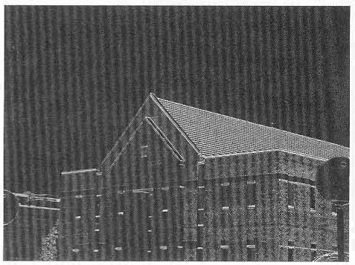
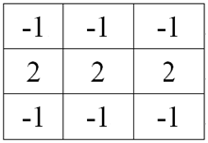
Edge-based segmentation
Point/edge detection
a point detection mask
Line detection
a line detection mask

Slide 18
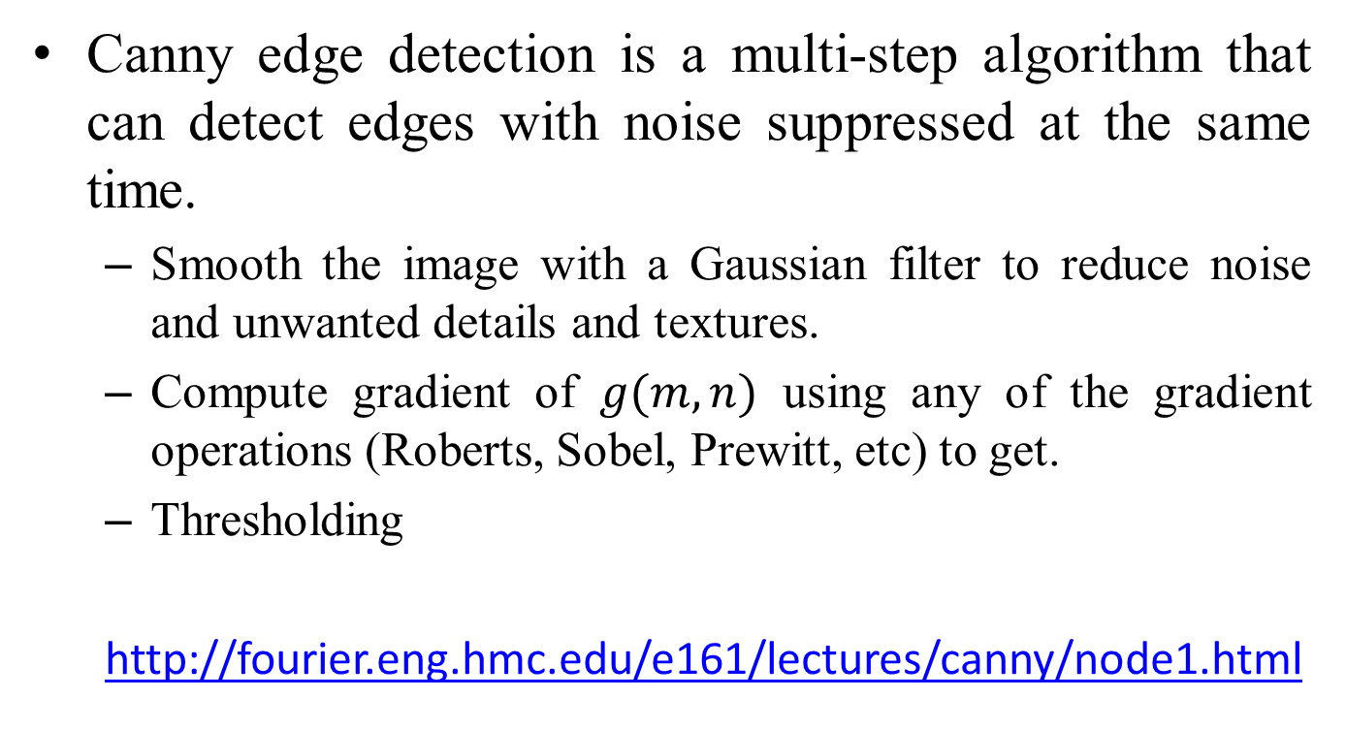
Canny Edge Detection
Canny edge detection is a multi-step algorithm that can detect edges with noise suppressed at the same time.
Smooth the image with a Gaussian filter to reduce noise and unwanted details and textures.
Compute gradient of $g(m,n)$ using any of the gradient operations (Roberts, Sobel, Prewitt, etc) to get.
Thresholding
http://fourier.eng.hmc.edu/e161/lectures/canny/node1.html

Slide 19
Gradient
The image gradient is to find edge strength and direction at location (x,y) of image.
The magnitude (length) of vector , denoted as M(x,y):
The direction of the gradient vector is given by the angle:

Slide 20
Edge-based segmentation
Edge detection: Laplacian operation

Slide 21
Region-based segmentation
Region-based segmentation is a technique for determining the region directly. The basic formulation is:
(a) R = i=1,..N U R(i)
(b) R(i) ∩ R(j) = 0 for i ≠ j
(c) P(R(i)) = TRUE for i = 1,2,…,N
(d) R(i) is a connected region, I = 1,…,N
(e) P(R(i) U R(j)) = FALSE for i ≠ j

Slide 22
Region-based segmentation
P(R(i)) is a logical predicate defined over the points in set and is the null set:
(a) means that the segmentation must be complete; that is, every pixel must be in a region.
(b) requires that points in a region must be connected in some predefined sense.
(c) indicates that the regions must be disjoint.
(d) deals with the properties that must be satisfied by the pixels in a segmented region. For example if all pixels in have the same grayscale.
(e) indicates that region and are different in the sense of predicate .

Slide 23
Seeded Region Growing (SRG)
Region growing: Groups pixels or sub-region into larger regions.
step1:
Start with a set of “seed” points and from these grow regions by appending to each seed those neighboring pixels that have properties similar to the seed.
step2:
Region splitting and merging

Slide 24
Region-based segmentation SRG
Advantage:
With good connectivity
Disadvantage:
Initial seed-points:
different sets of initial seed-point cause different segmented result
Time-consuming problem

Slide 25
Region-based segmentation USRG
Unseeded region growing:
no explicit seed selection is necessary, the seeds can be generated by the segmentation procedure automatically.
It is similar to SRG except the choice of seed point

Slide 26
Region-based segmentation USRG
Advantage:
easy to use
can readily incorporate high level knowledge of the image composition through region threshold
Disadvantage:
slow speed

Slide 27
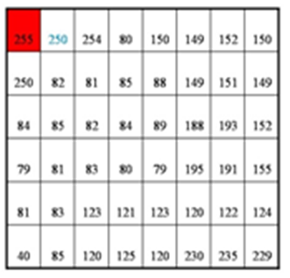
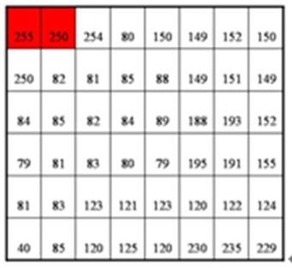
Region-based segmentation fast scanning
Fast scanning Algorithm:
The fast scanning algorithm somewhat resembles unseeded region growing
the number of clusters of both two algorithm would not be decided before image passing through them.

Slide 28
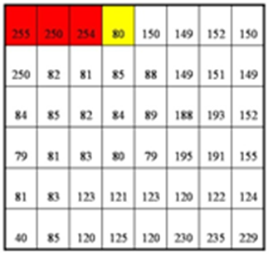
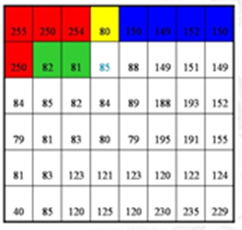
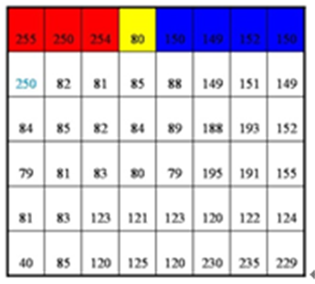
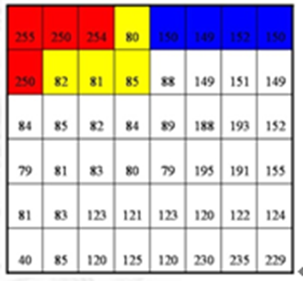
Region-based segmentation fast scanning

Slide 29
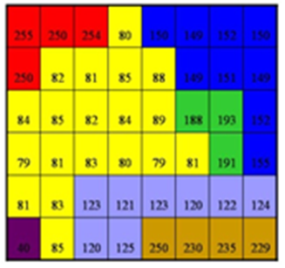
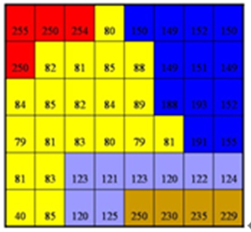
Region-based segmentation fast scanning
Last step:
merge small region to big region

Slide 30
Region-based segmentation fast scanning
Advantage:
The speed is very fast
The result of segmentation will be intact with good connectivity
Disadvantage:
The matching of physical object is not good
It can be improved by morphology and geometric mathematics

Slide 31
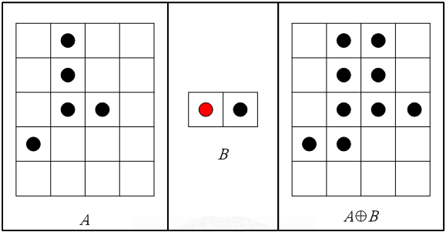
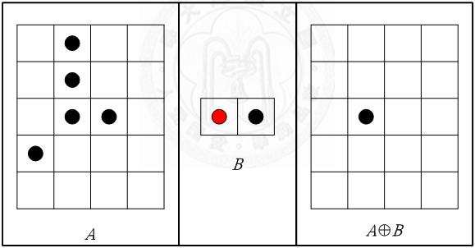
Region-based segmentation fast scanning-improved by morphology
dilation
erosion

Slide 32
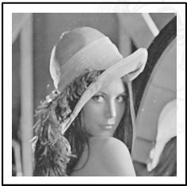
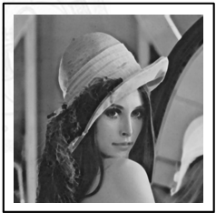
Region-based segmentation fast scanning-improved by morphology
dilation
erosion

Slide 33
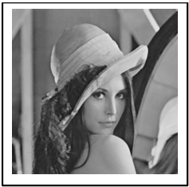
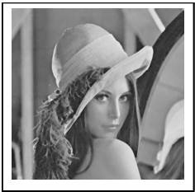
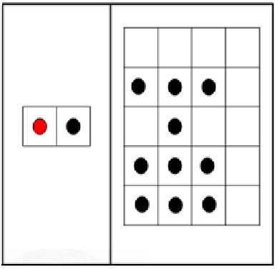
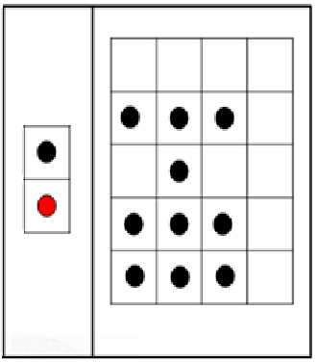
Region-based segmentation fast scanning-improved by morphology
opening
closing
Erosion=>Dilation
Dilation=>Erosion

Slide 34
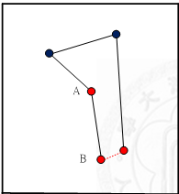
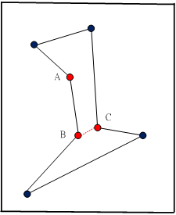
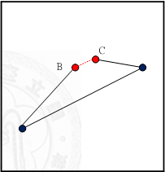
Region-based segmentation fast scanning-improved by Geometric Mathematic

Slide 35
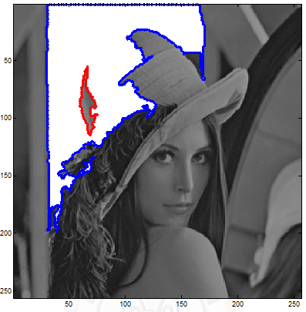
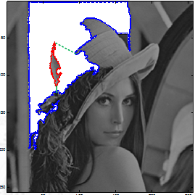
Region-based segmentation fast scanning-improved by Geometric Mathematic

Slide 36
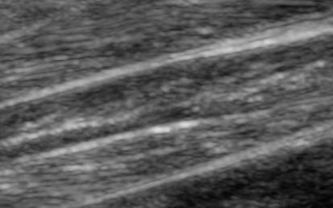

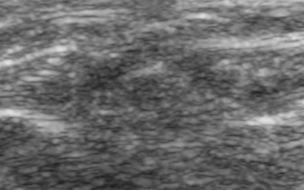
Region-based segmentation application
Muscle Injury Determination
How to judge for using image segmentation?
Use fast scanning algorithm to segment it.

Slide 37
Segmentation by Thresholding
Suppose that the gray-level histogram corresponds to an image f(x,y) composed of dark objects on the light background, in such a way that object and background pixels have gray levels grouped into two dominant modes. One obvious way to extract the objects from the background is to select a threshold ‘T’ that separates these modes.
Then any point (x,y) for which f(x,y) < T is called an object point, otherwise, the point is called a background point.

Slide 38
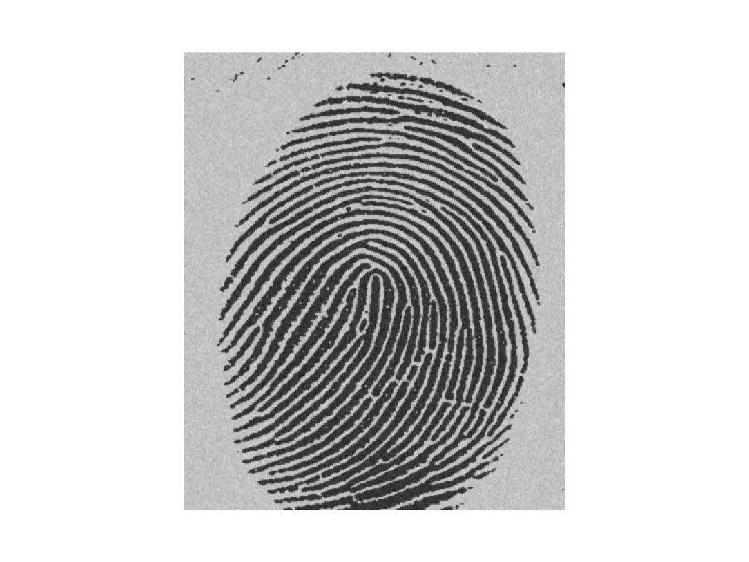
Gray Scale Image Example
Image of a Finger Print with light background

Slide 39
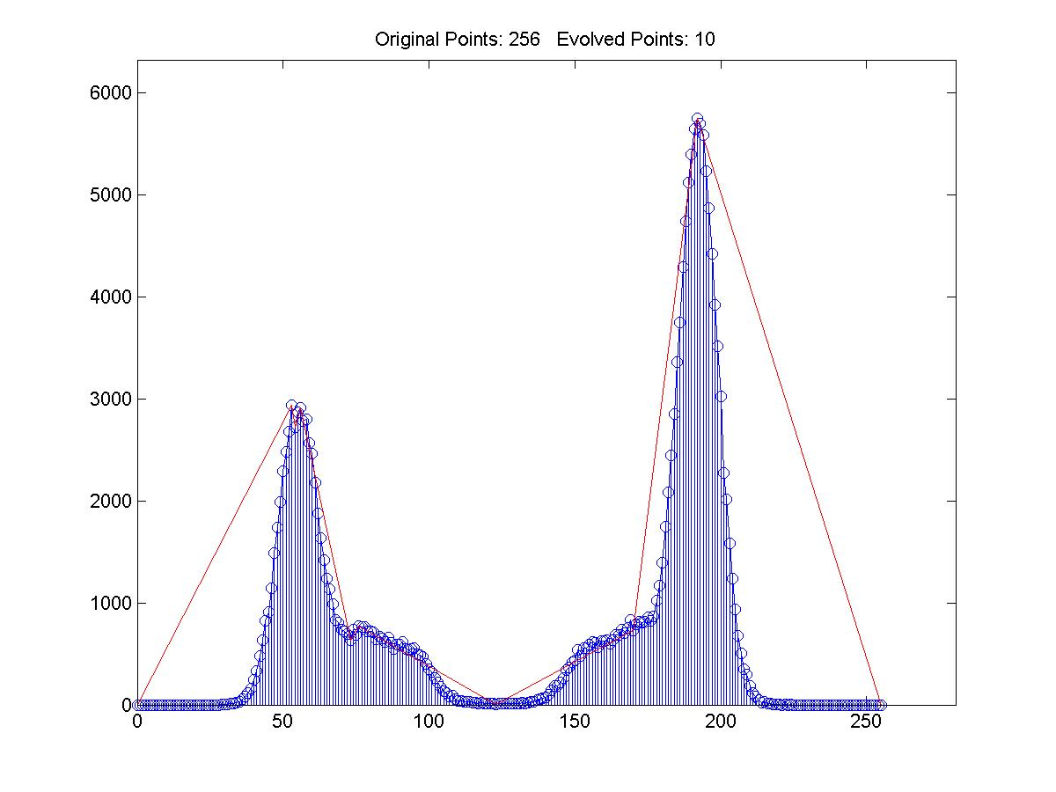
Histogram

Slide 40

Segmented Image
Image after Segmentation

Slide 41

Region-Filling

Slide 42

Clustering via K-Means Algorithm
An algorithm for partitioning (or clustering) N data points
into K disjoint subsets S_{j} containing N_{j} data points so as to
minimize the sum-of-squares criterion
data points
centroid
Initialization: randomly choose
K centroids
the data points are assigned to the K sets
the centroid is updated for each set

Slide 43
Subproblem I: Clustering by distance to known centers

Slide 44
Subproblem II: Finding the centers from known clustering

Slide 45
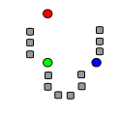
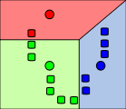
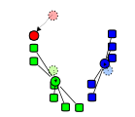
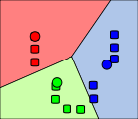
Example of Kmeans Clustering
1.Initialization
2.NN-Clustering
3.Codeword-update
4. Alternate 2 and 3
until convergence

Slide 46
K-means Clustering: Step 1
Algorithm: k-means, Distance Metric: Euclidean Distance
5
4
k₁
3
k₂
2
1
k₃
0
0
1
2
3
4
5

Slide 47
K-means Clustering: Step 2
Algorithm: k-means, Distance Metric: Euclidean Distance
5
4
k₁
3
k₂
2
1
k₃
0
0
1
2
3
4
5

Slide 48
K-means Clustering: Step 3
Algorithm: k-means, Distance Metric: Euclidean Distance
5
4
k₁
3
2
k₃
k₂
1
0
0
1
2
3
4
5

Slide 49
K-means Clustering: Step 4
Algorithm: k-means, Distance Metric: Euclidean Distance
5
4
k₁
3
2
k₃
k₂
1
0
0
1
2
3
4
5

Slide 50
K-means Clustering: Step 5
Algorithm: k-means, Distance Metric: Euclidean Distance
k₁
k₂
k₃

Slide 51
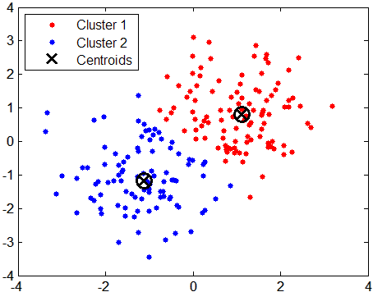
Data Clustering via Kmeans
Instead of 2D, kmeans can be applied to 3D color space RGB or L*a*b*

Slide 52
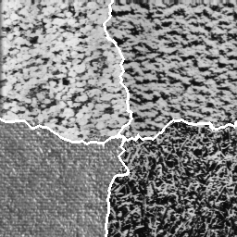
Texture-based Techniques
What is Texture?
No one exactly knows.
In the visual arts, texture
is the perceived surface quality
of an artwork.

Slide 53
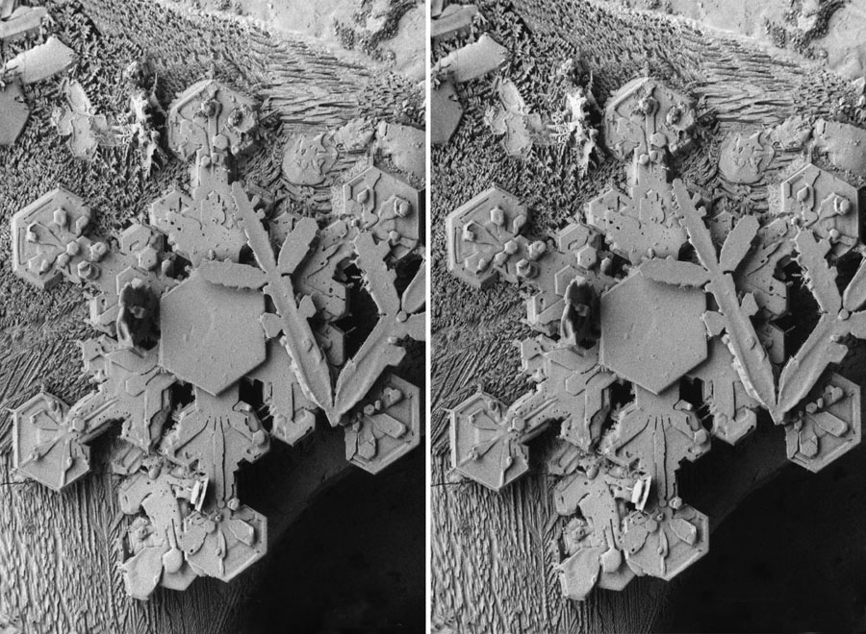
Disparity-based Techniques

Slide 54
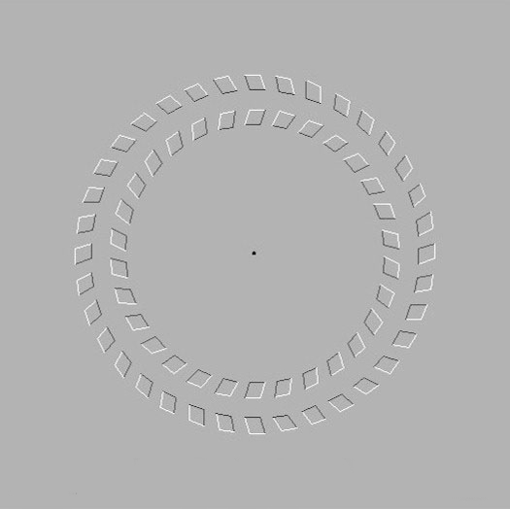
Motion Segmentation

Slide 55
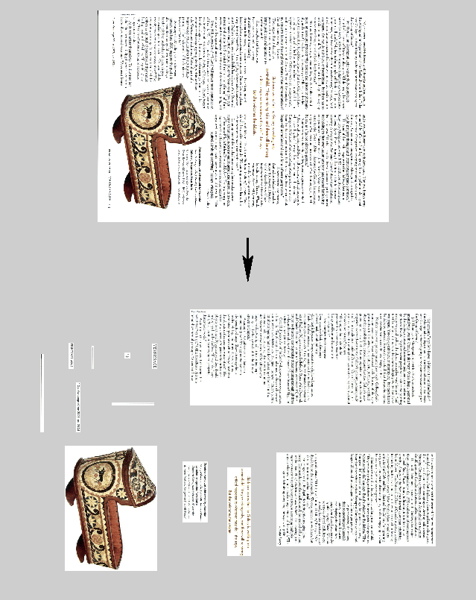
Document Segmentation
Document images consist of texts, graphics, photos and so on
Document segmentation is useful for compression, text recognition
Adobe and Xerox are the major players

Slide 56
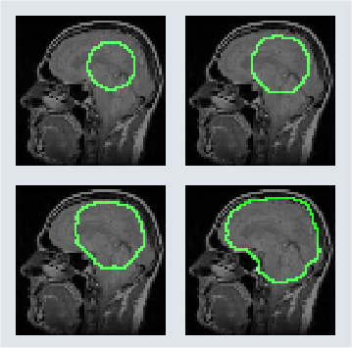
Medical Image Segmentation
Medical image analysis can be used as preliminary screening techniques to help doctors
Partial Differential Equation (PDE) has been used for segmenting medical images
active contour model (snake)

Slide 57
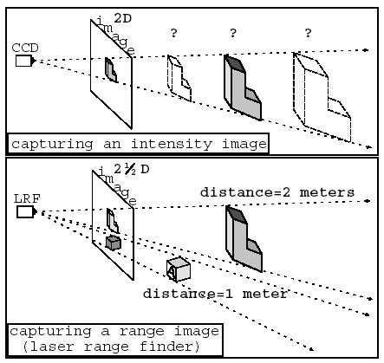
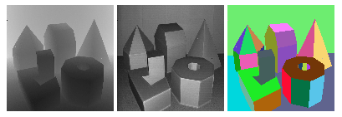
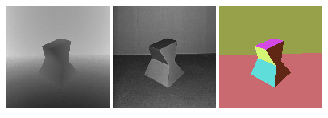
Range Image Segmentation
range
intensity
ground
truth

Slide 58
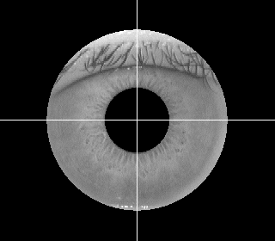
Biometric Image Segmentation
For fingerprint, face and iris images, we also need to segment out the region of interest
Various cues can be used such as ridge pattern, skin color and pupil shape
Robust segmentation could be difficult for poor-quality images

